Slide 1
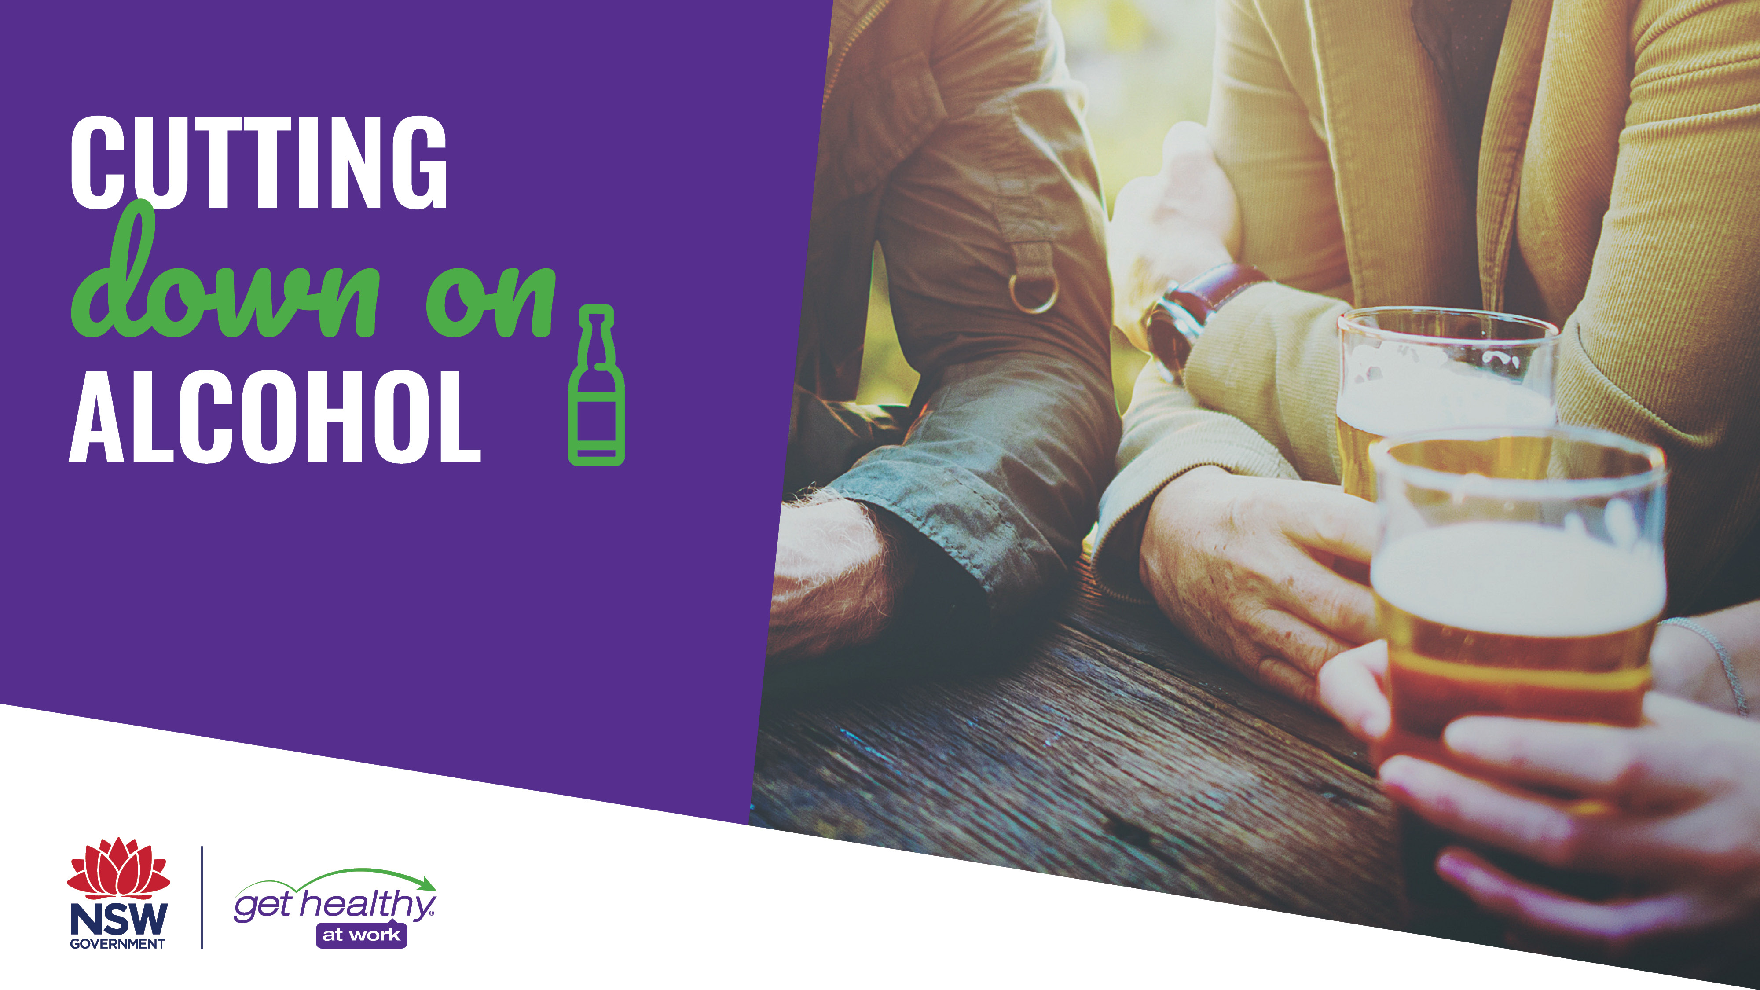
Notes:
Thanks for coming.
Today’s presentation is all about how to cut down on the amount of alcohol you drink and how you can find support to cut down.
(Click to next slide)

Slide 2
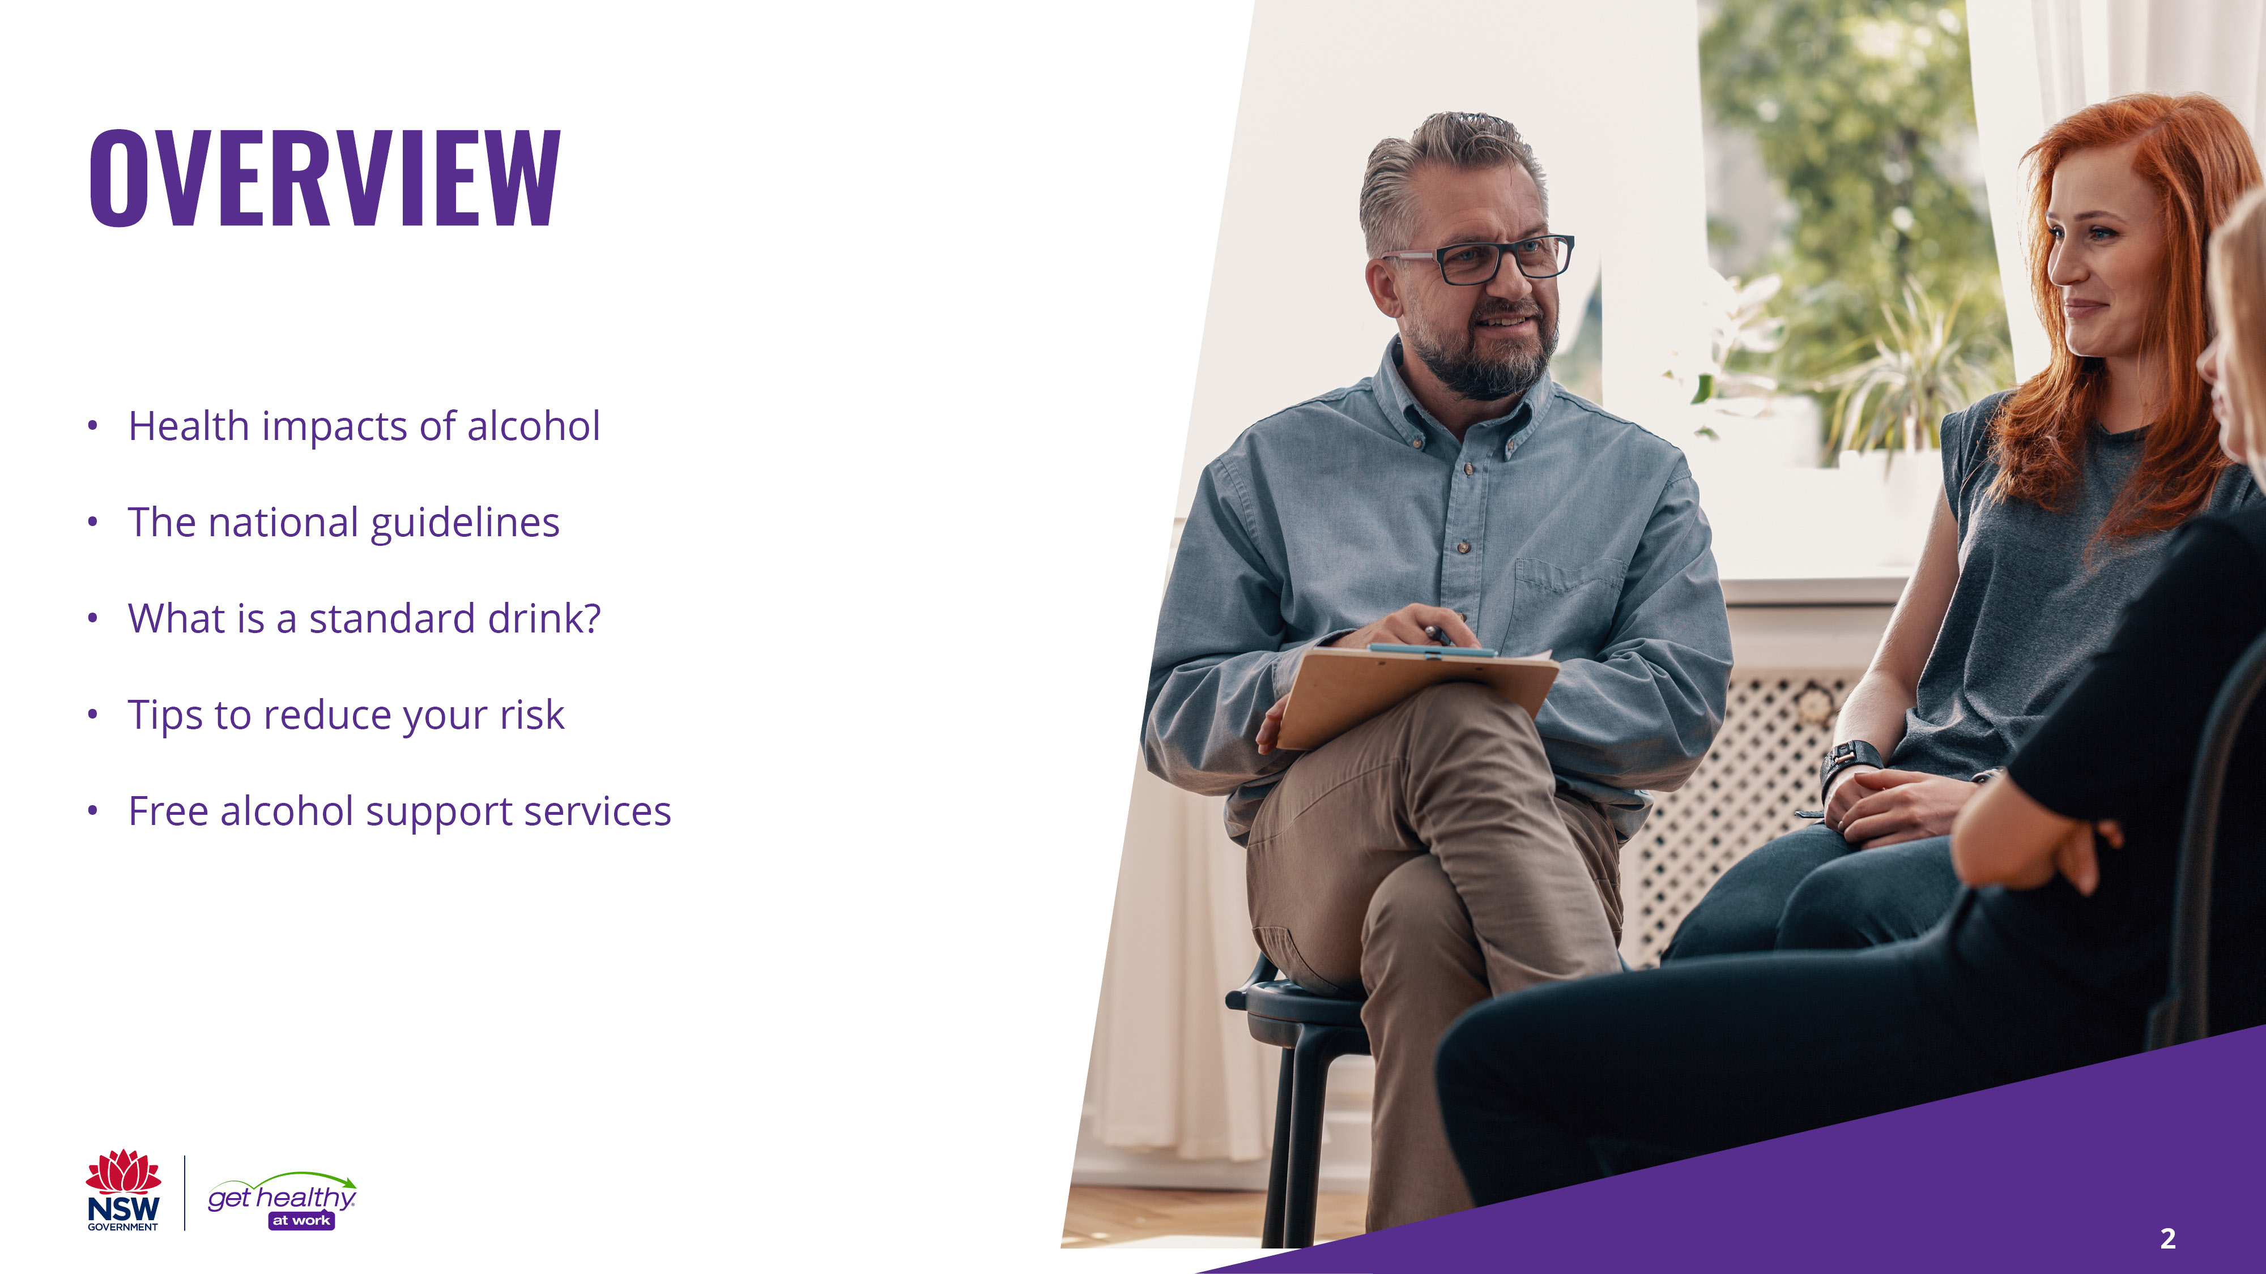
Notes:
In particular we’ll be talking about alcohol:
How it impacts health
The national guidelines for alcohol consumption
What a standard drinks is
Tips on how you can reduce your risk of harming your health from alcohol consumption AND
This presentation will finish by providing you with some information on free alcohol support services available in NSW
(Click to next slide)

Slide 3
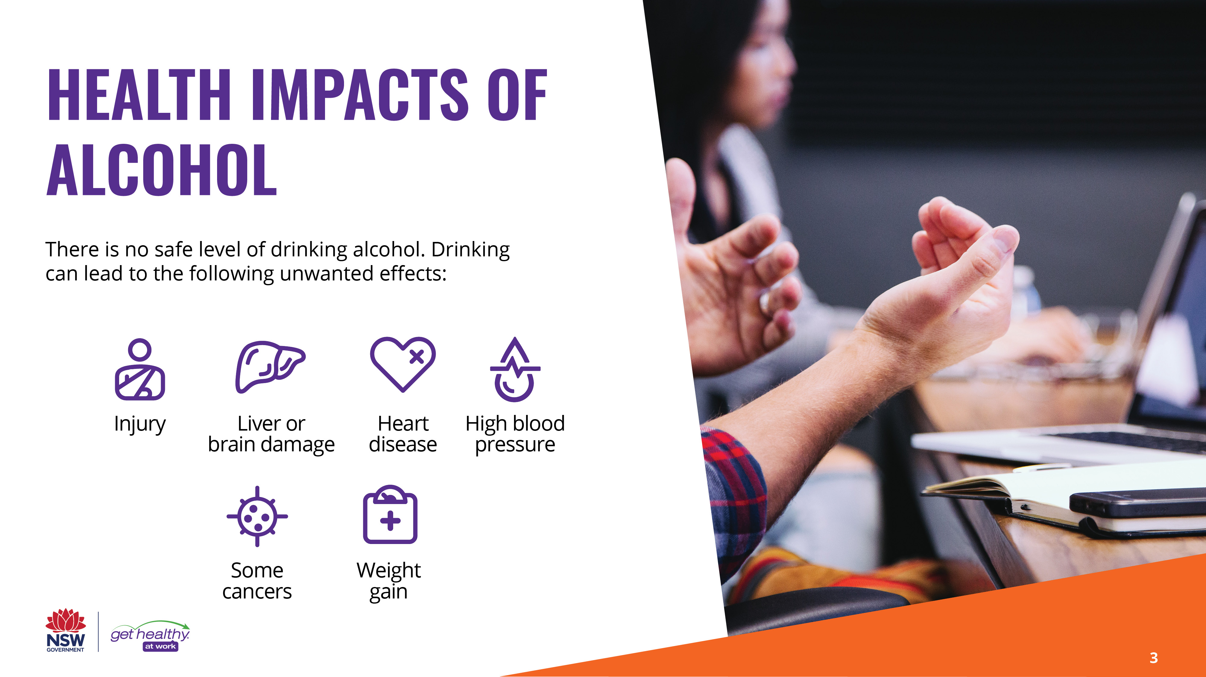
Notes:
Research from many agencies, including the Australian Institute for Health and Welfare, and DrinkWise, has shown that there is no safe level of alcohol consumption. There are both short term and long term health effects from drinking alcohol.
As many people are aware, in the short term alcohol can lead to:
Dizziness
Lack of judgement
Loss of coordination
Memory loss
Vomiting
Headaches and hangovers
Injury and
Alcohol poisoning
In the long term drinking alcohol can lead to:
Liver and brain damage
Heart disease
High blood pressure
Weight gain AND
Some cancers including; mouth, throat, oesophagus, stomach, bowel, liver and breast.
For a great video explaining the short and long term effects of alcohol, check out DrinkWise’s Effect of Alcohol YouTube video. https://www.youtube.com/watch?time_continue=20&v=RPEhIw3Ih28&feature=emb_logo
(Click to next slide)

Slide 4
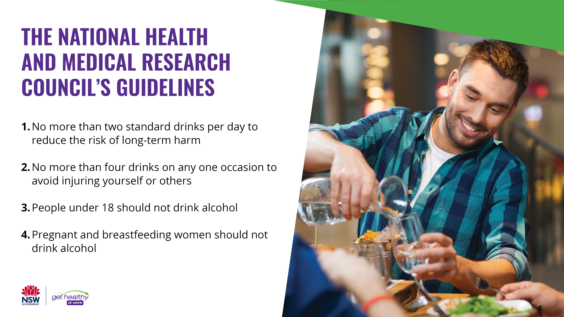
Notes:
The Australian Guidelines to drinking alcohol, developed by the National Health and Medical Research Council, are guidelines designed to provide advice on the health risks from drinking alcohol, so they can make informed decisions. The guidelines were not designed to tell Australians how much to drink.
The guidelines are currently being revised and will be released in 2020. The present guidelines recommend the following:
No more than two standard drinks per day to reduce the risk of long-term harm
No more than four drinks on any one occasion to avoid injuring yourself or others
People under 18 should not drink alcohol
Pregnant and breastfeeding women should not drink alcohol
(Click to next slide)
National Health and Medical Research Council. Australian guidelines to reduce health risks from drinking alcohol. Canberra: NHMRC; 2009 Available from: https://www.nhmrc.gov.au/about-us/publications/australian-guidelines-reduce-health-risks-drinking-alcohol

Slide 5
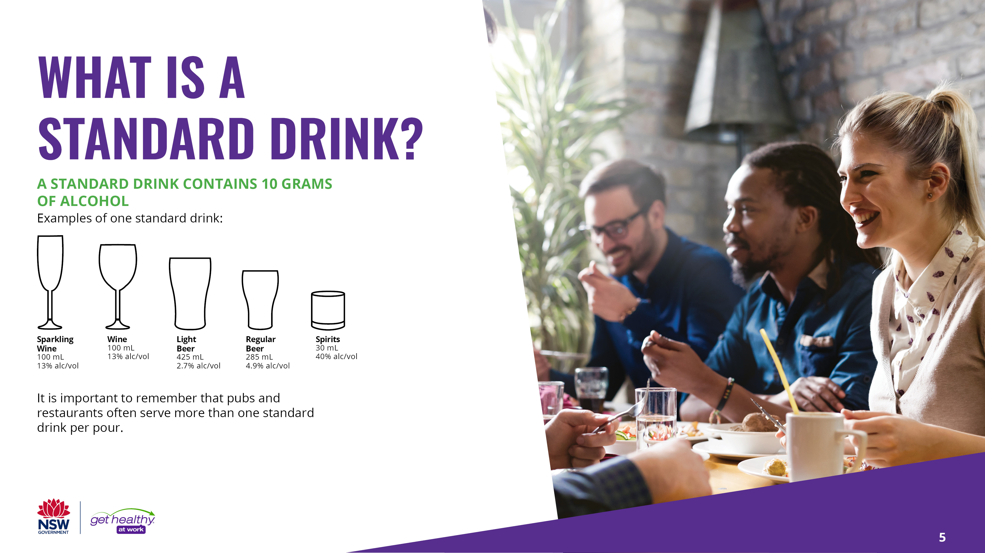
Notes:
A standard drink contains 10 grams of alcohol. Each of the drinks pictured here equals approximately one standard drink.
It is important to remember that a serving of alcohol in a pub or restaurant is often more than a ‘standard drink’.
For example, a glass of wine at a bar contains 1.5 standard drinks. The line on the glass usually doesn’t indicate a standard drink, rather the bar or restaurant’s standard pour. In regards to ordering tap beer, a schooner is 425mL. If you order a schooner of 5% beer, it will be 1.5 standard drinks. If you order a pint of a 5% beer, which is 570mL, it will be 2 standard drinks.
(Click to next slide)

Slide 6
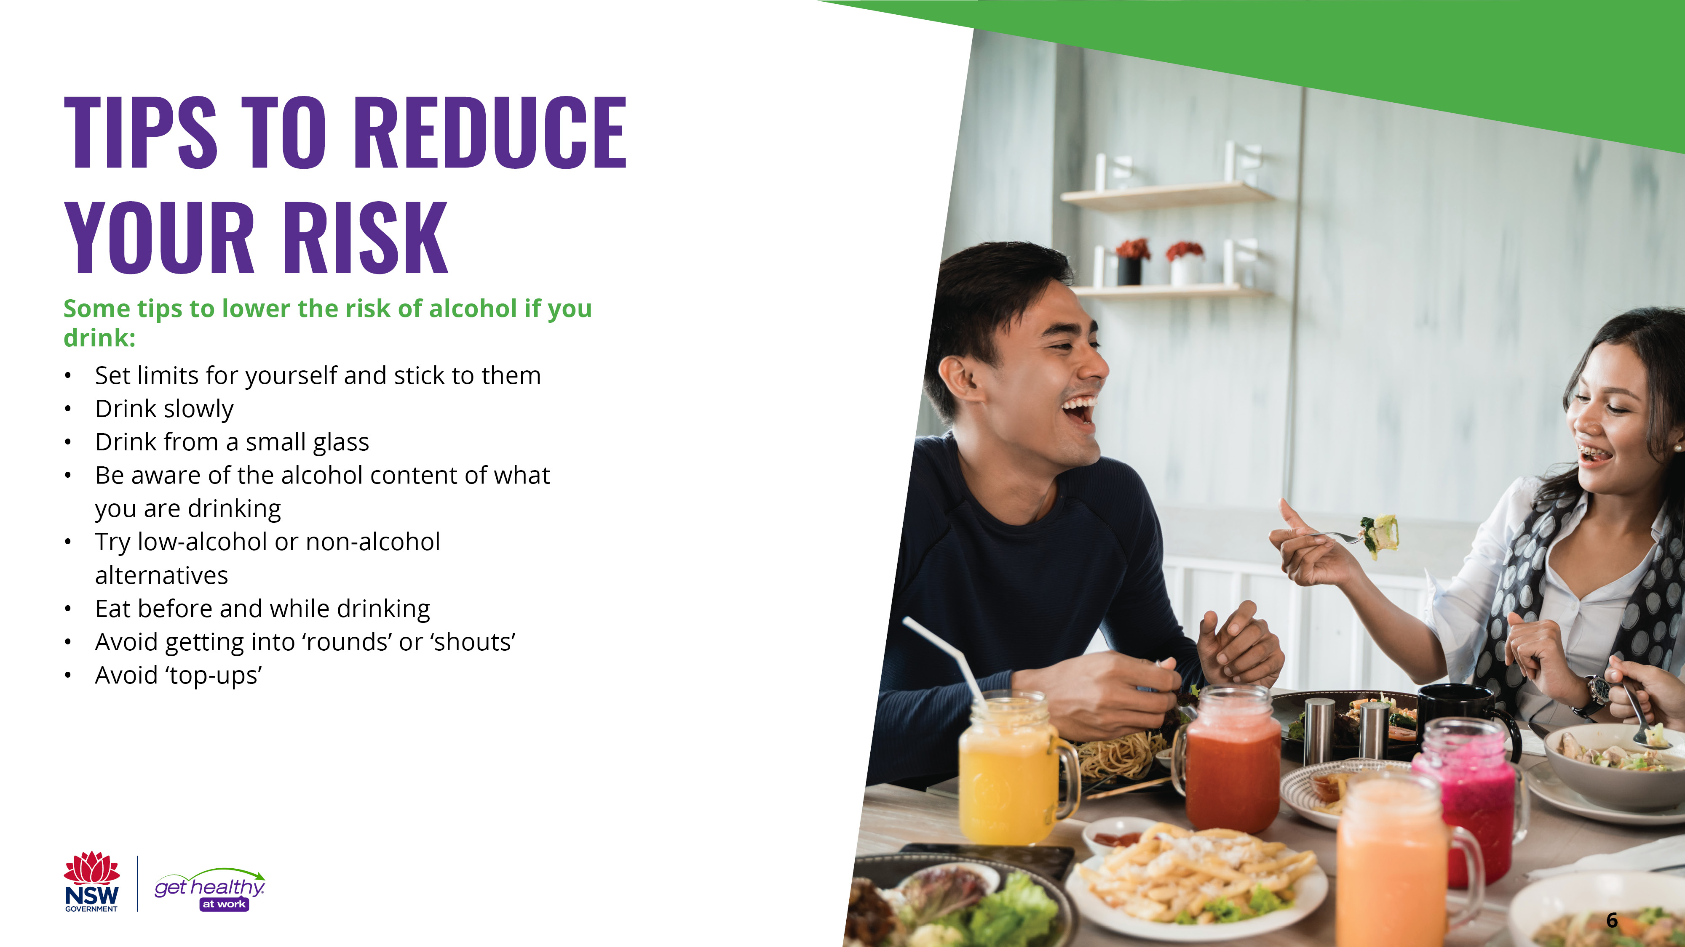
Notes:
When you do drink, there are many approaches you can take to reduce the amount of alcohol you drink and reduce the risk that alcohol can have on your health. These tips include:
• Set limits for yourself and stick to them. Don’t let other people pressure you into drinking more than you want.
• Drink slowly. Take sips, not gulps.
• Drink from a small glass. Some wine glasses can hold several standard drinks.
• Be aware of exactly what you are drinking. Remember that ‘alcopops’ (ready-to-drink or pre-mixed spirits or wine) can be quite strong, even though they don’t taste like strong alcohol.
• Try a low-alcohol or non-alcoholic alternative.
• Eat before and while drinking but avoid salty snacks, which can make you thirsty.
• Avoid getting into ‘rounds’ or ‘shouts’. They are likely to make you drink more than you would otherwise drink.
• Avoid ‘top ups’. Drink one drink at a time so it’s easier to keep track of how much you are drinking.
(Click to next slide)

Slide 7
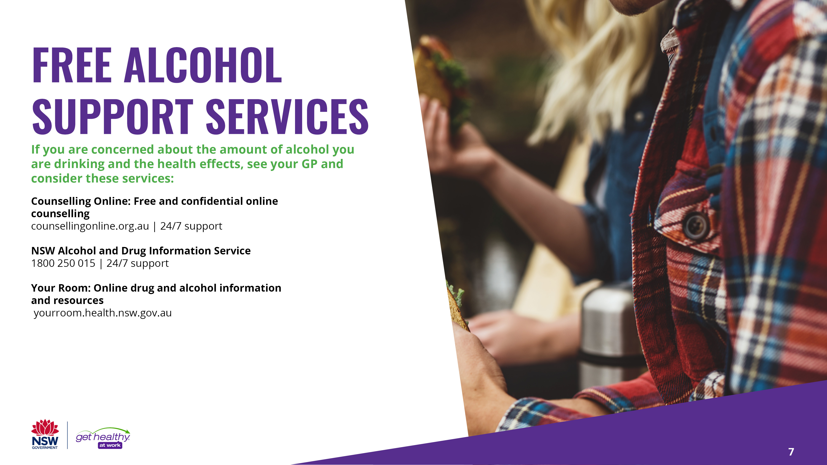
Notes:
If you are concerned about the amount of alcohol you are drinking and the health effects, either see your GP or utilise one of the many free alcohol support and treatment services on offer across NSW. These services are available to support individuals, family and friends of someone with a substance problem, or to help the workplace understand how they can support a worker with an alcohol problem.
Counselling online is a free and confidential online alcohol and other drugs counselling service which is available 24 hours a day, 7 days a week.
The NSW Alcohol and Drug Information Service is a confidential information, advice and referral telephone service that provides education, information, support, crisis counselling and referral to services in NSW. It is also available 24 hours a day, 7 days a week.
Your Room is an online drug and alcohol information website that offers free resources and interactive tools.
(Click to next slide)

Slide 8
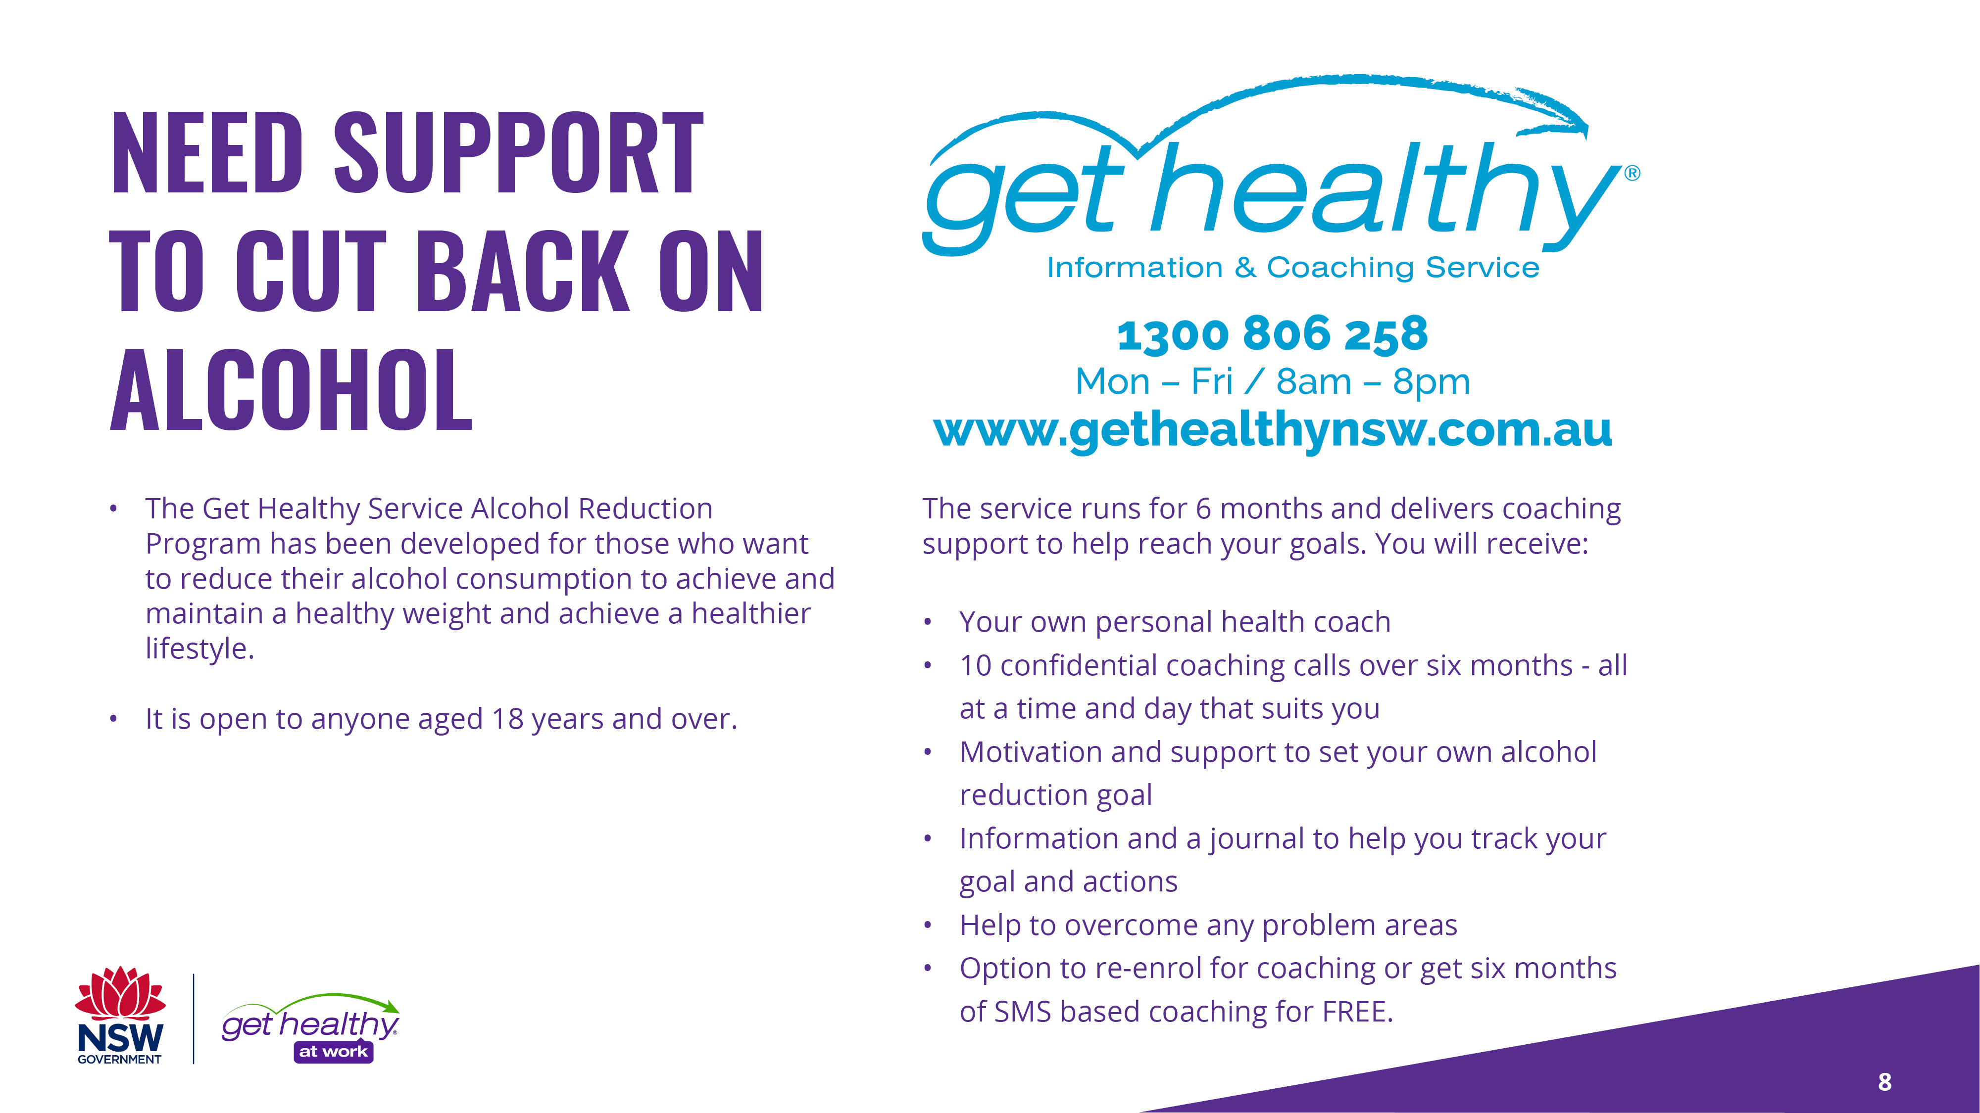
Notes:
One great service that you can use for free is the Get Healthy Service’s alcohol reduction program. It has been designed to help those looking to reduce their alcohol consumption and to help achieve a healthy weight and maintain a healthier lifestyle. It is open to anyone who is 18 years old or over.
By taking up the program, you will receive 6 months of over the phone health coaching, your own personal health coach, and 10 confidential coaching calls with your health coach, all at a time and day that suits you. You will be able to set your own alcohol reduction goals. And the service offers the option to re-enroll or receive six months of SMS based coaching. Every part of the program is free.
(Click to next slide)

Slide 9
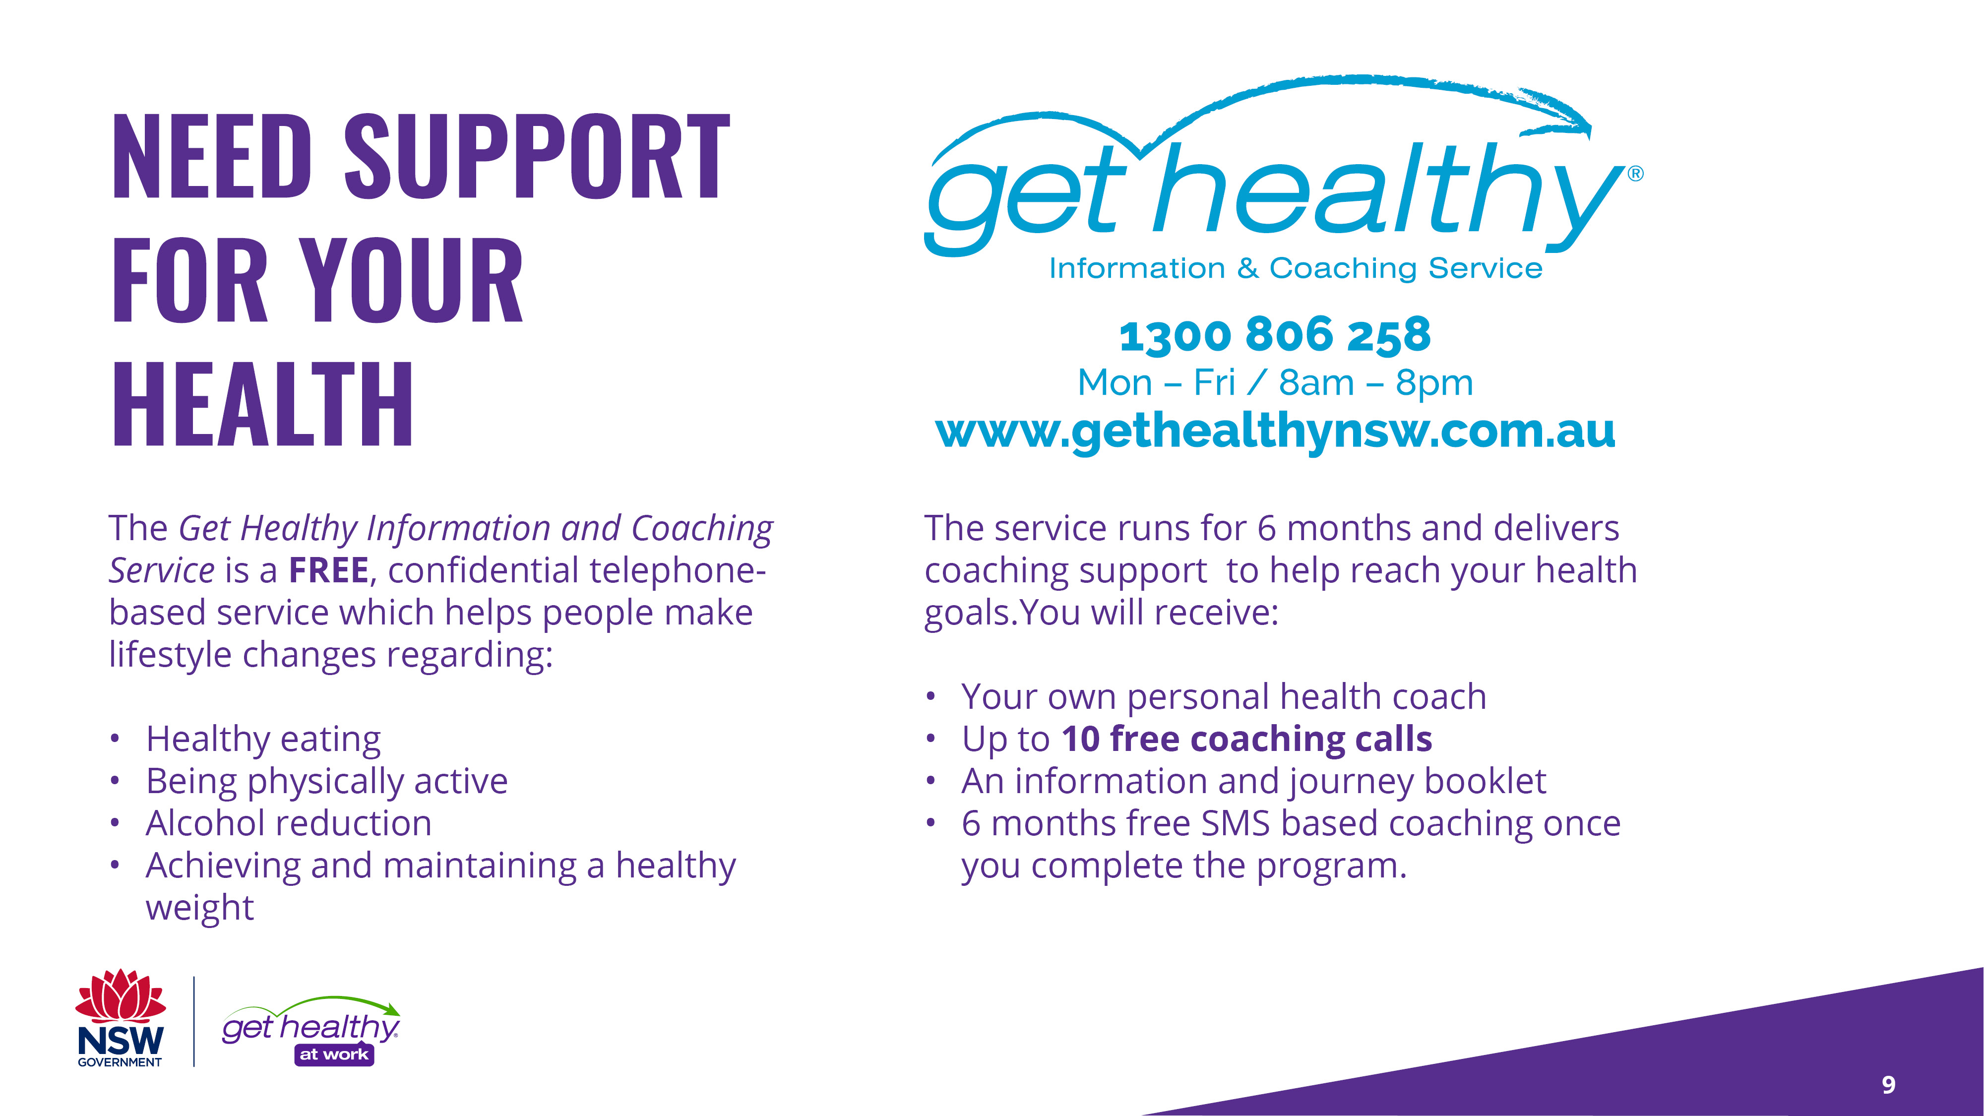
Notes:
This brings us to the end of the presentation. Before you go I would like to quickly tell you about the other great services that you can utilise through the Get Healthy Service in addition to their Alcohol Reduction Program.
Similar to the Alcohol Reduction Program, you receive 10 free coaching calls over a 6 month period as well as 6 months free SMS based coaching once you complete the program, all of which is entirely for free for the following areas:
Eat Healthy
Be physically active
Achieve and maintain a healthy weight
On average participants lose 3.8kg and 5.1cm off their waist.
As part of participating in Get Healthy at Work our workplace is allowing you to complete your coaching calls during work time if needed.
(Click to next slide)

Slide 10
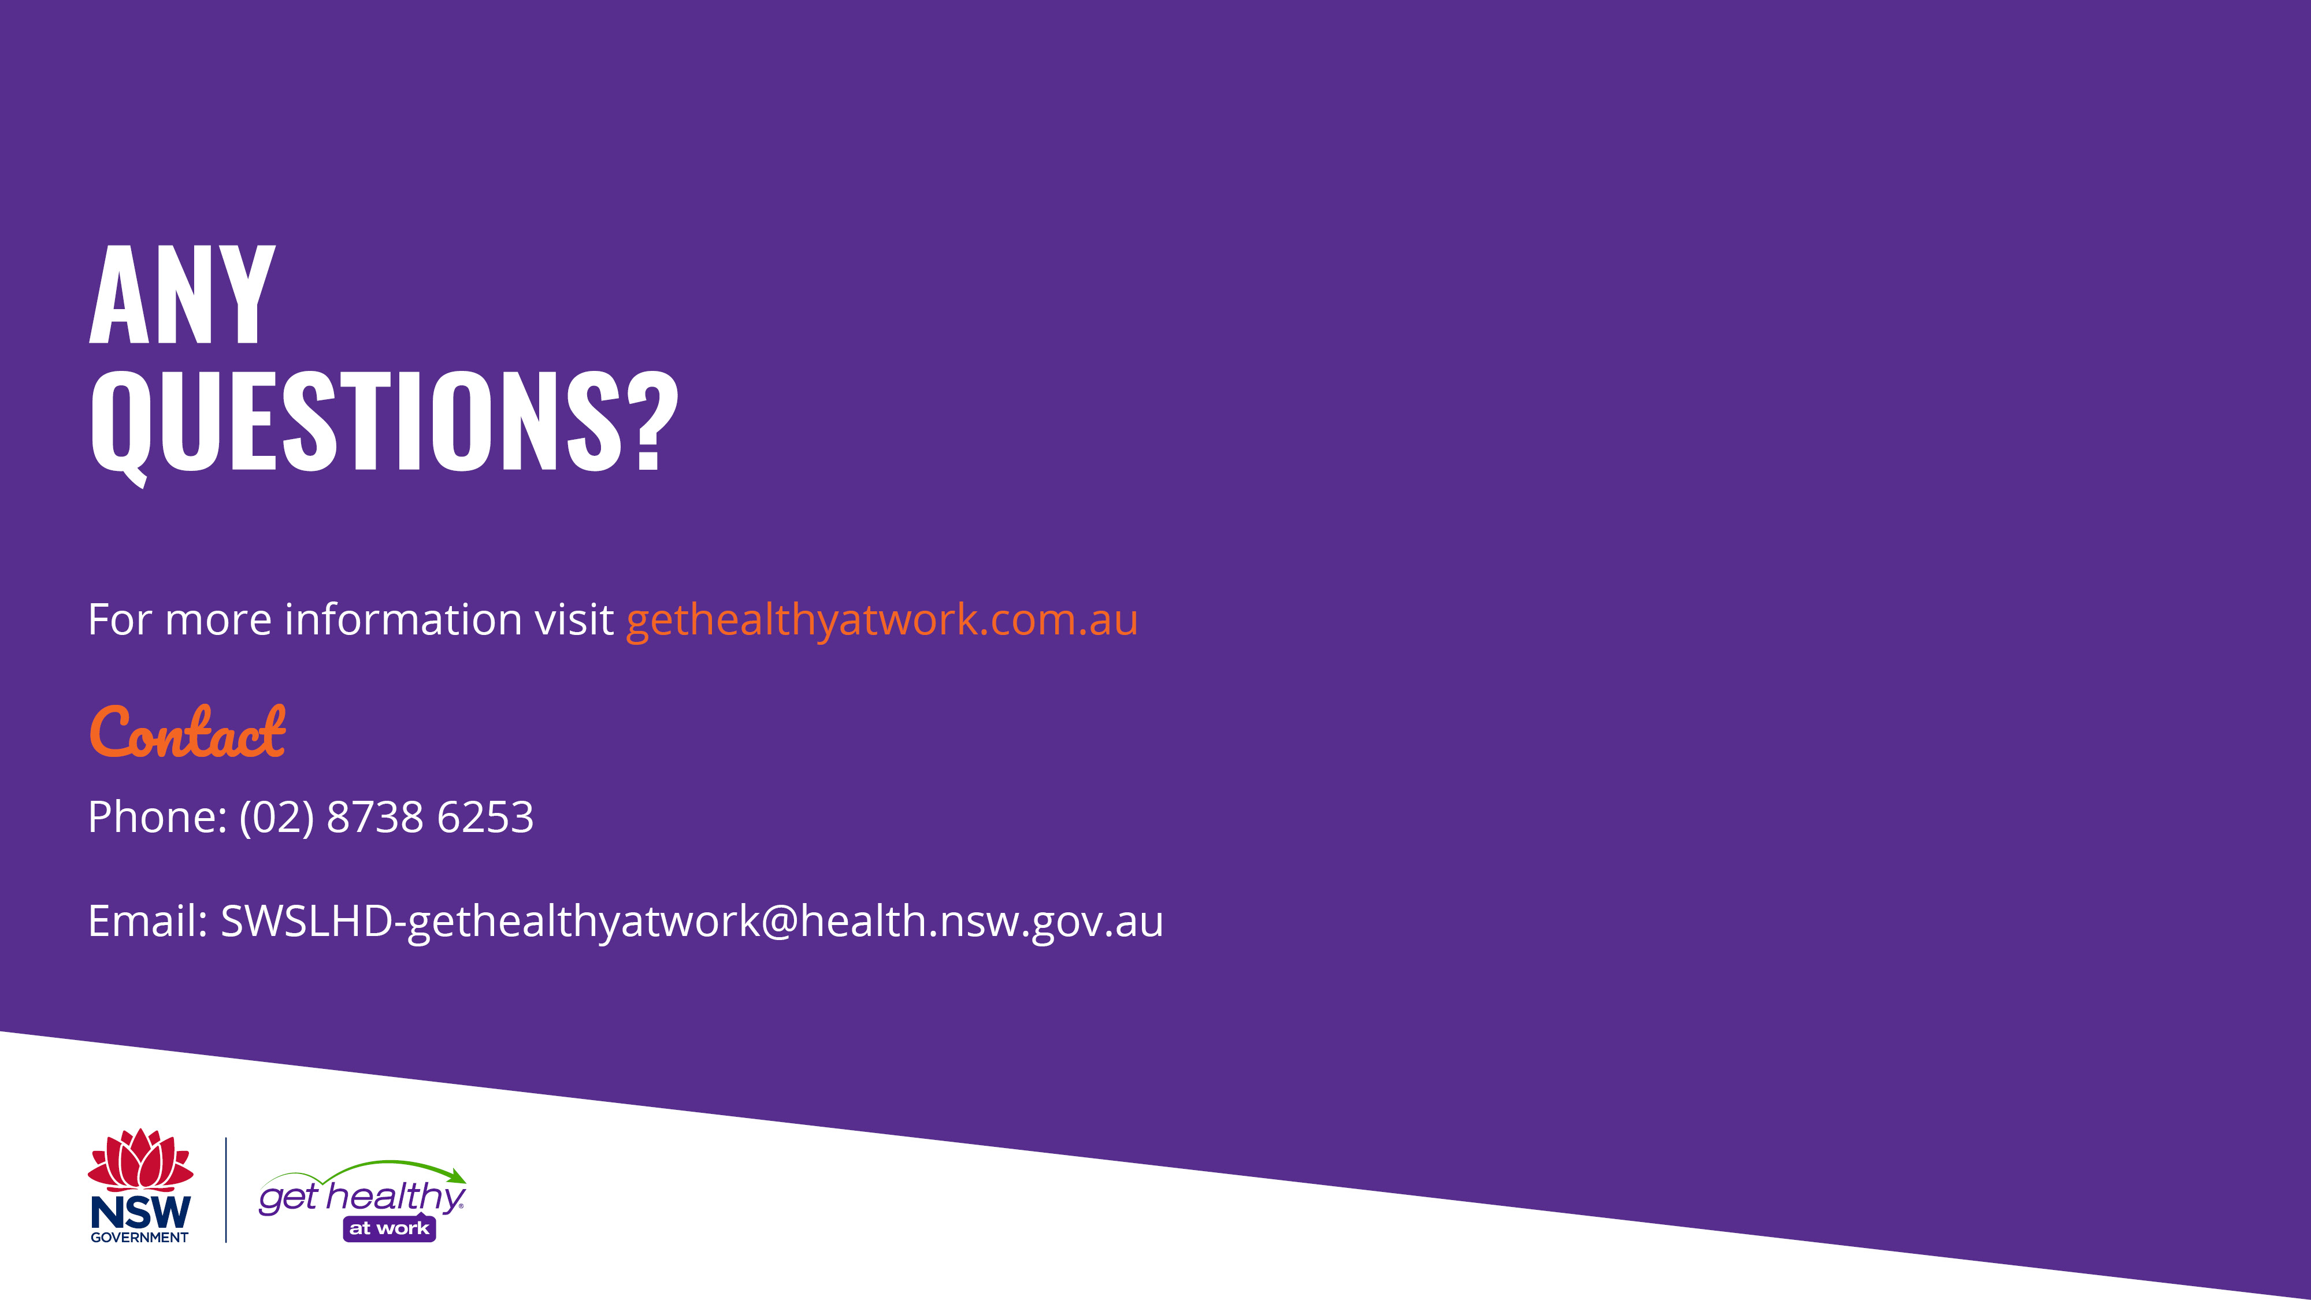
Notes:
If you have any questions about the presentation, please let me know. If you have any questions about the Get Healthy at Work program, please contact the Get Healthy at Work team using the contact details here.
(End presentation)

